Slide 1

Insert school logo here
"Somewhere, something incredible is waiting to be known."
- Carl Sagan
Insert school banner branding here

Slide 2






Enrichment for 21st Century Student
“…the action of improving or enhancing the quality or value of something”
“… learn the ‘people’ skills that you need to succeed in adulthood”

Slide 3
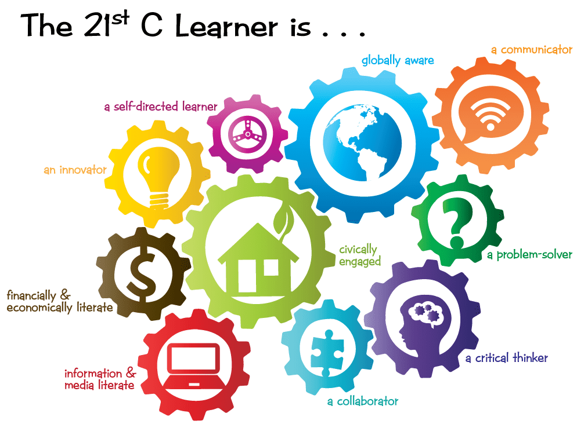
21st Century Student
21st century children need to be able to think creatively, work creatively with others and also implement innovation in their everyday lives (NEA, 2012; Partnership for 21st Century Skills, 2009).
21st century skills refer to the knowledge, life skills, career skills, habits, and traits that are critically important to student success in today’s world, particularly as students move on to college, the workforce, and adult life.
To be successful in the futures means its much more than being an academic.

Slide 4
So why do ‘the skills’ matter
Higher-education and business leaders cite soft skills as being the most important driver of success in higher-level courses and in the workplace.
In today’s world, we are preparing you for jobs that might not yet exist. Career readiness means equipping you with a set of skills that can prepare you for the unknown.
Social media and COVID has changed human interaction and created new challenges in navigating social situations.
The age of the Internet has dramatically increased access to knowledge. You need to learn how to process and analyse large amounts of information.
Content knowledge from core subjects can only go so far; you need to be taught how to apply facts and ideas towards complex problems.

Slide 5

Why is Enrichment important?
Life and social skills
Supports 21st Century Student
Confidence
Depth & understanding
Application of learning leading to better outcomes
Notes:
Life and social skills – life requires you to deal and operate in lots of different settings
Confidence, both in yourself as a young person and also your academic ability, hopefully helping you to achieve and attain
Depth & understanding – of subjects/learning

Slide 6
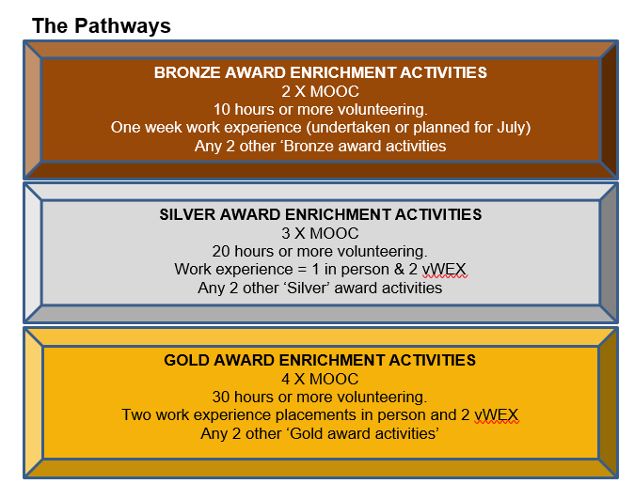
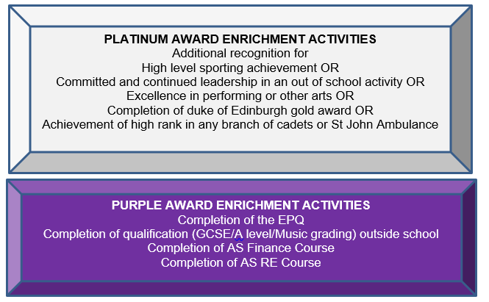
What does enrichment look like?

Slide 7
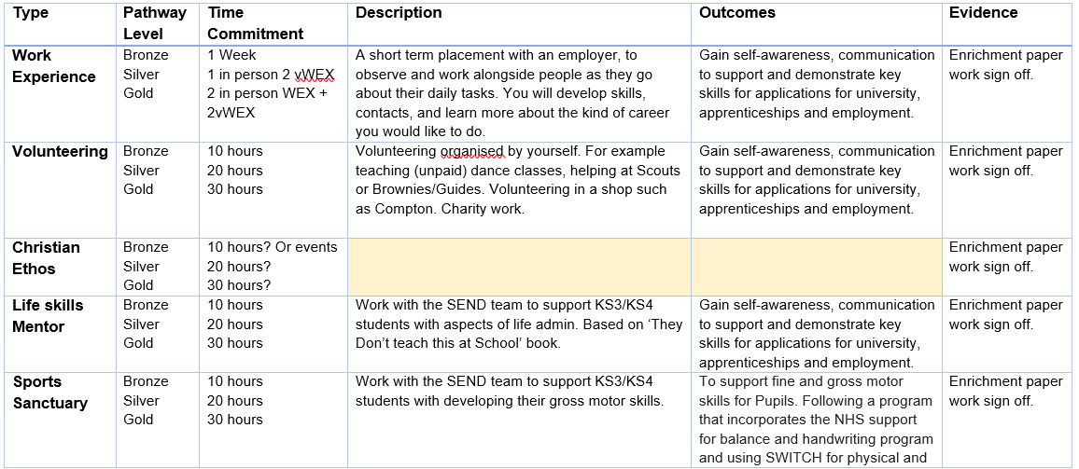
Example Activities

Slide 8
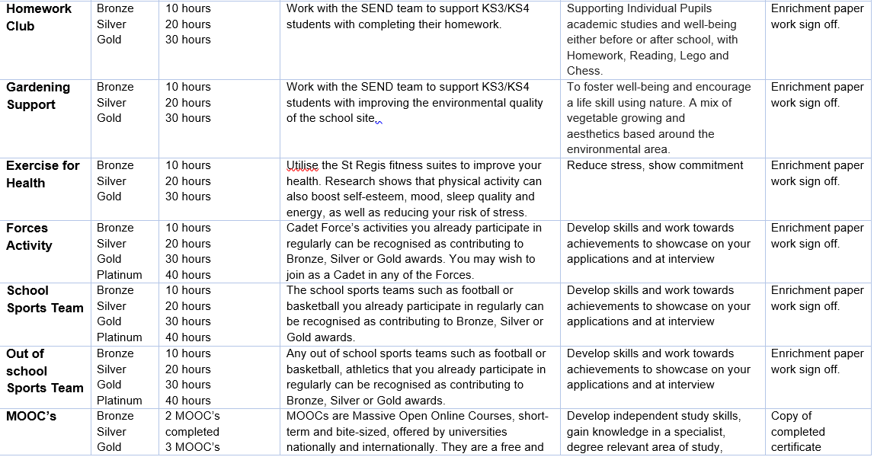
Example Activities

Slide 9
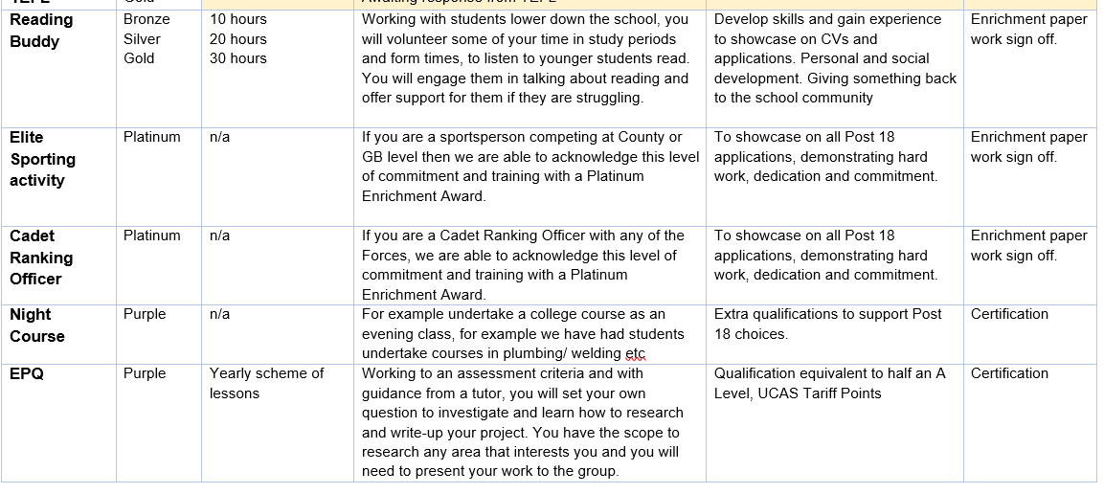
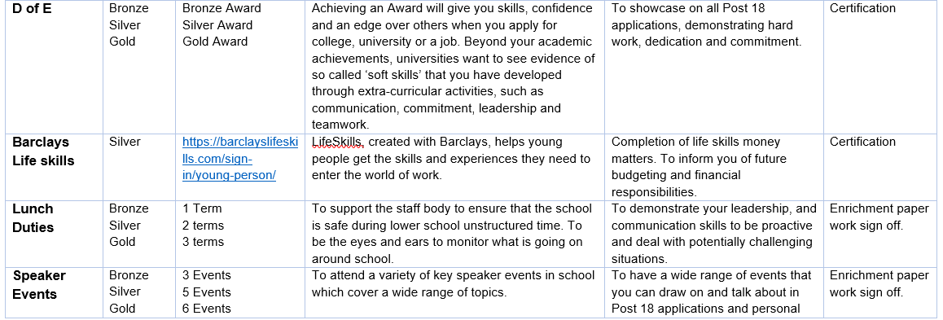
Example Activities

Slide 10
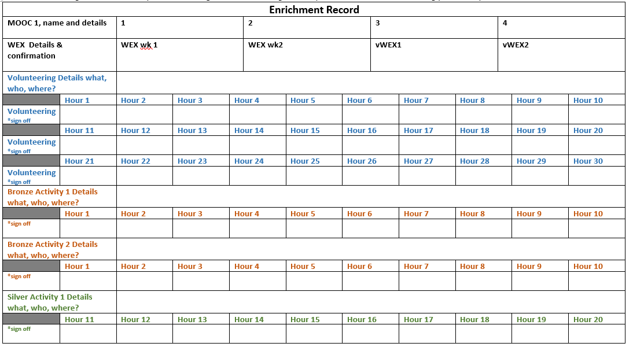

Slide 11

Why bother?
Prepare you for life after sixth form
Help develop the skills you need to be successful in adulthood
Give something back to the school and local communities
Being a good role model
AND…
On completion of your bronze pathway we will pay for
your driving license.

Slide 12

Anything missing?
Exploring & expanding opportunities
If there is something you're interested in experiencing and learning more about then let us know!

